Slide 1

Natural Language Processing
Rohit Kate
Transformers – Part 1

Slide 2
Reading
Sections 8.3 & 8.4 (skip the code), Textbook 1

Slide 3
Learnable Attention
green_{v}*f(green_{q},green_{k}) +
green_{v}
green_{q}
green_{k}
W_{values}
W_{query}
W_{keys}
green
green
green

Slide 4
Learnable Attention
green_{v}*f(green_{q},green_{k}) +
small_{v}*f(green_{q},small_{k}) +
small_{v}
small_{k}
W_{values}
W_{query}
W_{keys}
small
small

Slide 5
Learnable Attention
green’ =
green_{v}*f(green_{q},green_{k}) +
small_{v}*f(green_{q},small_{k}) +
tree_{v}*f(green_{q},tree_{k})
tree_{v}
tree_{k}
W_{values}
W_{query}
W_{keys}
tree
tree

Slide 6
Learnable Attention
green’
Self-attention
green
small
tree

Slide 7
Learnable Attention
small’
Self-attention
green
small
tree

Slide 8
Learnable Attention
tree’
Self-attention
green
small
tree

Slide 9
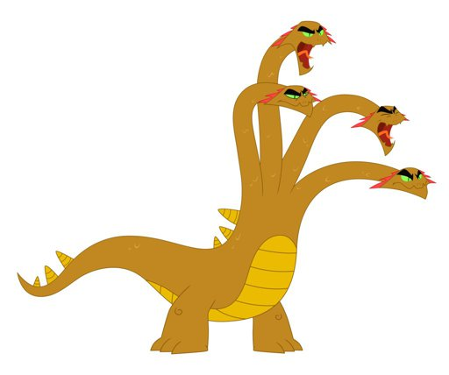
Multi-Head Attention
In each layer, instead of using a single set of attention weights, it has been found beneficial to use multiple sets of attention weights
This is called multi-head attention
Could be looked upon as parallel attention layers
The idea is that it will capture multiple representations (different pieces of information) useful for the task
Experimentally found to do better than single attention
The computed representations are then concatenated
Number of attention heads is a parameter

Slide 10
Two Attention Heads
green_{v1}*f(green_{q1},green_{k1}) +
green_{v2}*f(green_{q2},green_{k2}) +
green_{v1}
green_{v2}
green_{q1}
green_{q2}
green_{k1}
green_{k2}
W_{values1}
W_{values2}
W_{query1}
W_{query2}
W_{keys1}
W_{keys2}
green
green
green

Slide 11
Two Attention Heads
green_{v1}*f(green_{q1},green_{k1}) +
small_{v1}*f(green_{q1},small_{k1}) +
green_{v2}*f(green_{q2},green_{k2}) +
small_{v2}*f(green_{q2},small_{k2}) +
small_{v1}
small_{v2}
small_{k1}
small_{k2}
W_{values1}
W_{values2}
W_{query1}
W_{query2}
W_{keys1}
W_{keys2}
small
small

Slide 12
Two Attention Heads
green1’ =
green_{v1}*f(green_{q1},green_{k1}) +
small_{v1}*f(green_{q1},small_{k1}) +
tree_{v1}*f(green_{q1},tree_{k1})
green2’ =
green_{v2}*f(green_{q2},green_{k2}) +
small_{v2}*f(green_{q2},small_{k2}) +
tree_{v2}*f(green_{q2},tree_{k2})
green’ = green1’ gree2’
tree_{v1}
tree_{v2}
tree_{k1}
tree_{k2}
W_{values1}
W_{values2}
W_{query1}
W_{query2}
W_{keys1}
W_{keys2}
tree
tree

Slide 13
Self-Attention Inside Encoder
We can use multiple layers of self-attention layers:
New representations
Complete Encoder
green’’’’’
small’’’’’
tree’’’’’
Self-attention
green’’’’
small’’’’
tree’’’’
Self-attention
green’’’
small’’’
tree’’’
Self-attention
green’’
small’’
tree’’
Self-attention
green’
small’
tree’
Self-attention
green
small
tree

Slide 14
Encoder-Decoder Attention
representation
verde
green small tree
<sos> arbolito

Slide 15
Encoder-Decoder Attention
The query will come from the decoder
Different set of W_{values}, W_{query} and W_{keys}

Slide 16
Encoder-Decoder Attention
green_{v}*f(arbolito_{q},green_{k}) +
green_{v}
arbolito_{q}
green_{k}
W_{values}
W_{query}
W_{keys}
green
arbolito
green

Slide 17
Encoder-Decoder Attention
green_{v}*f(arbolito_{q},green_{k}) +
small_{v}*f(arbolito_{q},small_{k}) +
small_{v}
small_{k}
W_{values}
W_{query}
W_{keys}
small
small

Slide 18
Encoder-Decoder Attention
arbolito’ =
green_{v}*f(arbolito_{q},green_{k}) +
small_{v}*f(arbolito_{q},small_{k}) +
tree_{v}*f(arbolito_{q},tree_{k})
tree_{v}
tree_{k}
W_{values}
W_{query}
W_{keys}
tree
tree

Slide 19
Transformers
Vaswani A, Shazeer N, Parmar N, Uszkoreit J, Jones L, Gomez AN, Kaiser Ł, Polosukhin I. Attention is all you need. In Advances in neural information processing systems 2017 (pp. 5998-6008).
http://papers.nips.cc/paper/7181-attention-is-all-you-%0Aneed.pdf
More than 96,000 citations so far

Slide 20
Transformer Model
State-of-the-art results on many NLP tasks have been obtained using transformer-based architectures
Uses self-attention to transform input (e.g. a sentence) into a new representation
Typically a few times
Uses attention over the new representation (encoder-decoder attention) as well as self-attention to generate output (e.g. the translated sentence)
Typically a few times

Slide 21
Illustrative Example
Gif image runs continuously and repeatedly…
Image Source: https://ai.googleblog.com/2017/08/transformer-novel-neural-network.html

Slide 22
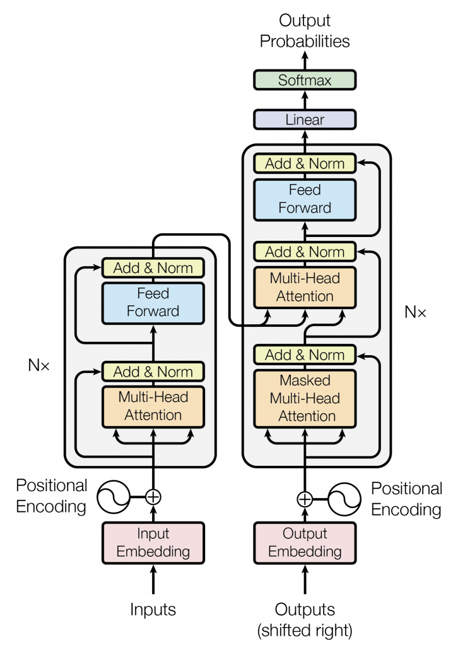
Big Picture
Encoder-Decoder
attention
Multiple layers inside decoder
Multiple layers
inside encoder
Self-attention
Self-attention
Figure 1 from the paper.

